Slide 1
Worksheet – Earthquake P-wave & S-wave Travel Time Chart Tutorial

Slide 2
1) If you are asked the travel time of a P-wave or S-wave for a given epicenter distance:
a) Go to the epicenter distance on the x-axis and go up to the correct curve,
b) Go over to the y-axis and determine the travel time.
Example 1: How long does it take a P-wave to travel 4,000 km?
Answer: 7 minutes

Slide 3
2) If you are asked for the epicenter distance a P-wave or S-wave traveled for a given travel time:
a) Go to the travel time on the y-axis and go over to the correct curve,
b) Go down to the x-axis to determine the epicenter distance.
Example 5: How far can an S-wave travel in 9 minutes?
Answer: 2,600 km

Slide 4
3) If you are asked for the origin time (the time an earthquake occurred):
a) Determine the travel time of the given wave (see #1)
b) Subtract arrival time you were given minus the travel time.
Example 9: If a P-wave arrives at a station 8,000 km away at 12:15:00, what time did the earthquake originate?
12:15:00
- 00:11:20
Answer: 12:03:40

Slide 5
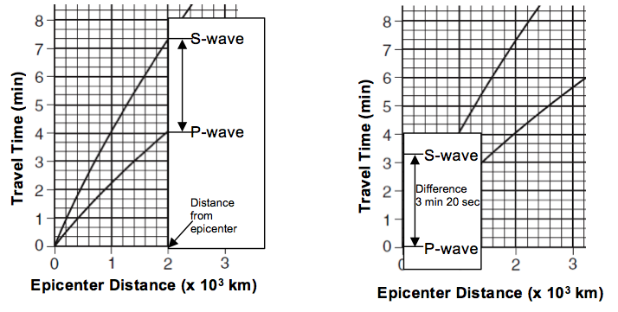
4) If you are asked to determine the difference in arrival time between P-waves and S-waves:
Line up a piece of scrap paper vertically on the epicenter distance given.
Mark the locations where the P-wave and S-wave intersect your scrap paper.
Line up the scrap paper on the y-axis with one point on the 0 minute mark.
The second mark will indicate the difference in arrival time.

Slide 6
4) If you are asked to determine the difference in arrival time between P-waves and S-waves:
Line up a piece of scrap paper vertically on the epicenter distance given.
Mark the locations where the P-wave and S-wave intersect your scrap paper.
Line up the scrap paper on the y-axis with one point on the 0 minute mark.
The second mark will indicate the difference in arrival time.
Example 11: An epicenter station is 5,000 km away. How long after the first P-wave did the first S-wave arrive?

Slide 7
4) If you are asked to determine the difference in arrival time between P-waves and S-waves:
Line up a piece of scrap paper vertically on the epicenter distance given.
Mark the locations where the P-wave and S-wave intersect your scrap paper.
Line up the scrap paper on the y-axis with one point on the 0 minute mark.
The second mark will indicate the difference in arrival time.
Example 11: An epicenter station is 5,000 km away. How long after the first P-wave did the first S-wave arrive?
Answer: 6 min 40 sec

Slide 8
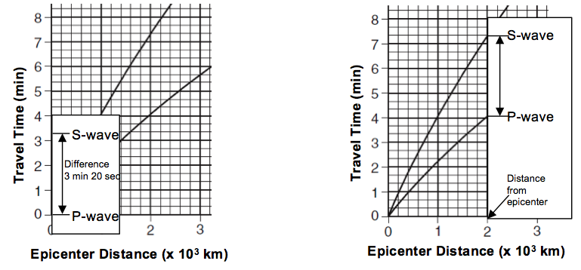
5) If you are asked to determine the epicenter distance using the difference in arrival time of P-wave and S-wave:
Find the difference in clock time between the P-wave and S-wave by subtracting the given times.
Use the Y-axis (time travel) and use a piece of scrap paper to mark the time difference.
Place the marked scrap paper between the P-wave and S-wave line on the graph. Slide the scrap paper along the graph to find the location that the interval is touching both P-wave and S-wave line.
Determine the epicenter distance of this location using the X-axis.

Slide 9
5) If you are asked to determine the epicenter distance using the difference in arrival time of P-wave and S-wave:
Find the difference in clock time between the P-wave and S-wave by subtracting the given times.
Use the Y-axis (time travel) and use a piece of scrap paper to mark the time difference.
Place the marked scrap paper between the P-wave and S-wave line on the graph. Slide the scrap paper along the graph to find the location that the interval is touching both P-wave and S-wave line.
Determine the epicenter distance of this location using the X-axis.
Example 12: The first P-wave arrived at a seismic station at 10:00:00. The first S-wave arrived at the same seismic station at 10:08:40. How far is this seismic station from the epicenter?
10:08:40
- 10:00:00
00:08:40

Slide 10
5) If you are asked to determine the epicenter distance using the difference in arrival time of P-wave and S-wave:
Find the difference in clock time between the P-wave and S-wave by subtracting the given times.
Use the Y-axis (time travel) and use a piece of scrap paper to mark the time difference.
Place the marked scrap paper between the P-wave and S-wave line on the graph. Slide the scrap paper along the graph to find the location that the interval is touching both P-wave and S-wave line.
Determine the epicenter distance of this location using the X-axis.
Example 12: The first P-wave arrived at a seismic station at 10:00:00. The first S-wave arrived at the same seismic station at 10:08:40. How far is this seismic station from the epicenter?
Answer: 7,200 km

